Slide 1
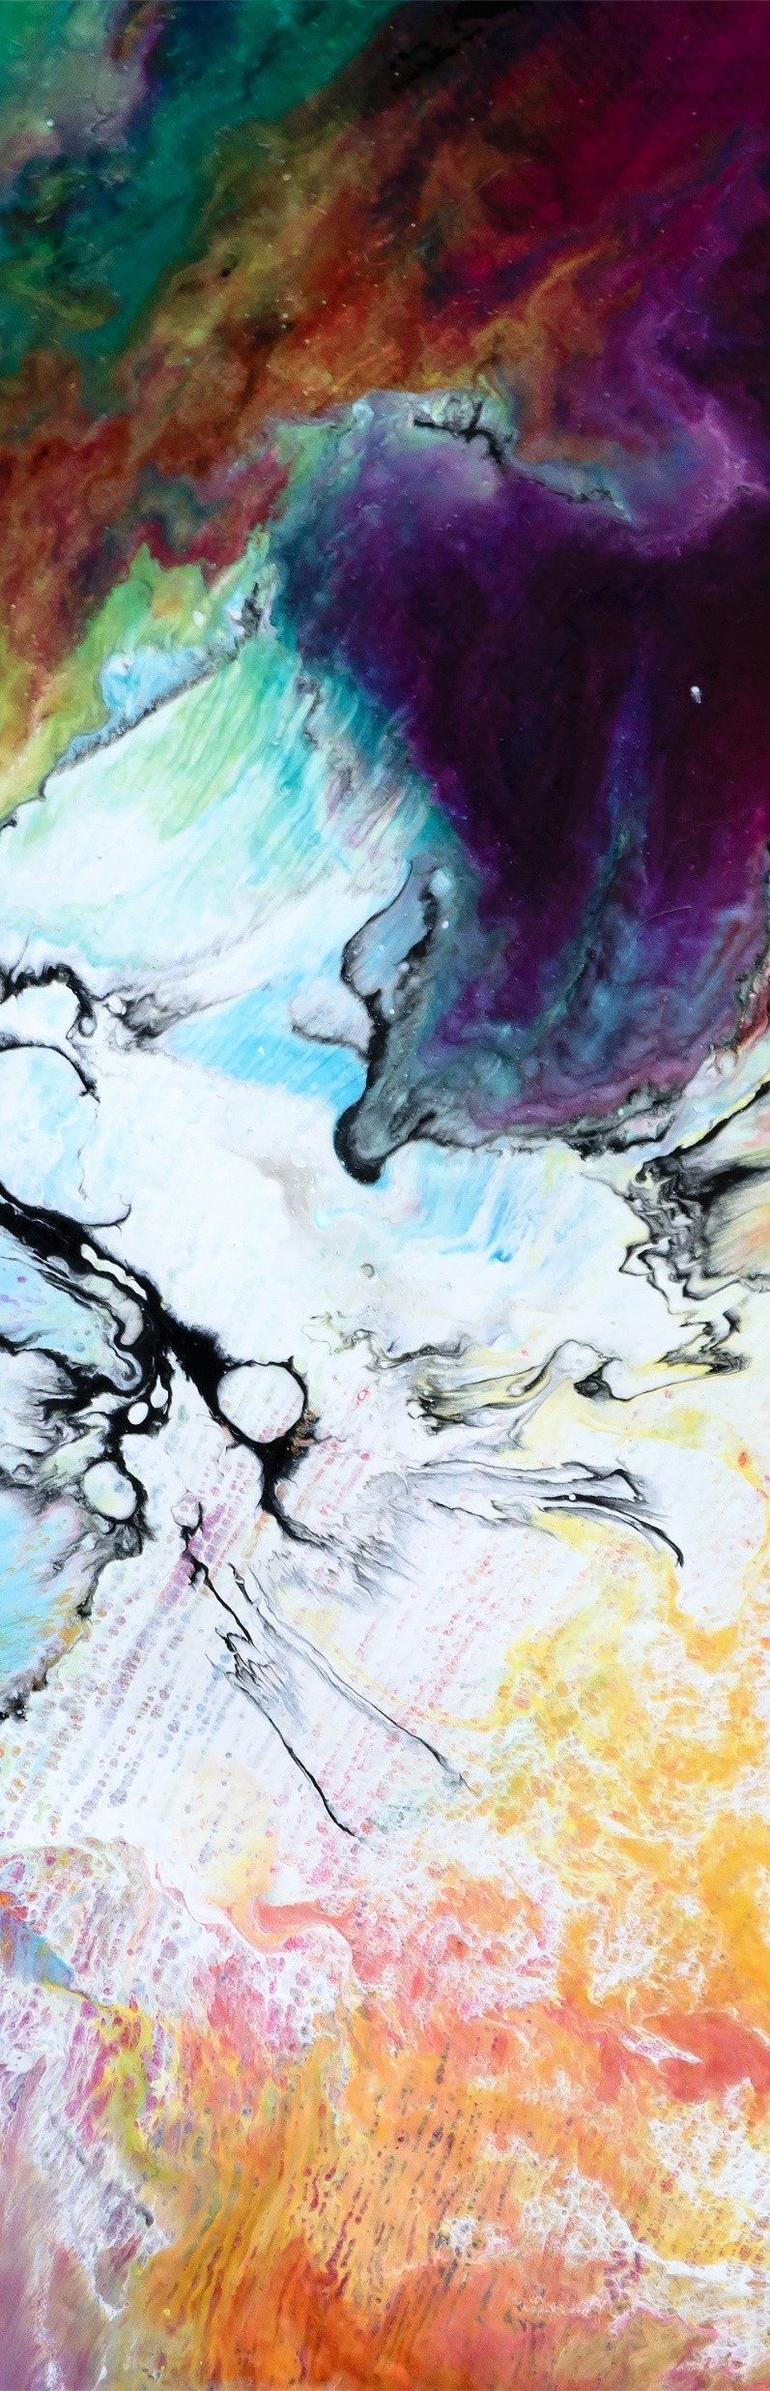
Image segmentation
PATTERN RECOGNITION

Slide 2
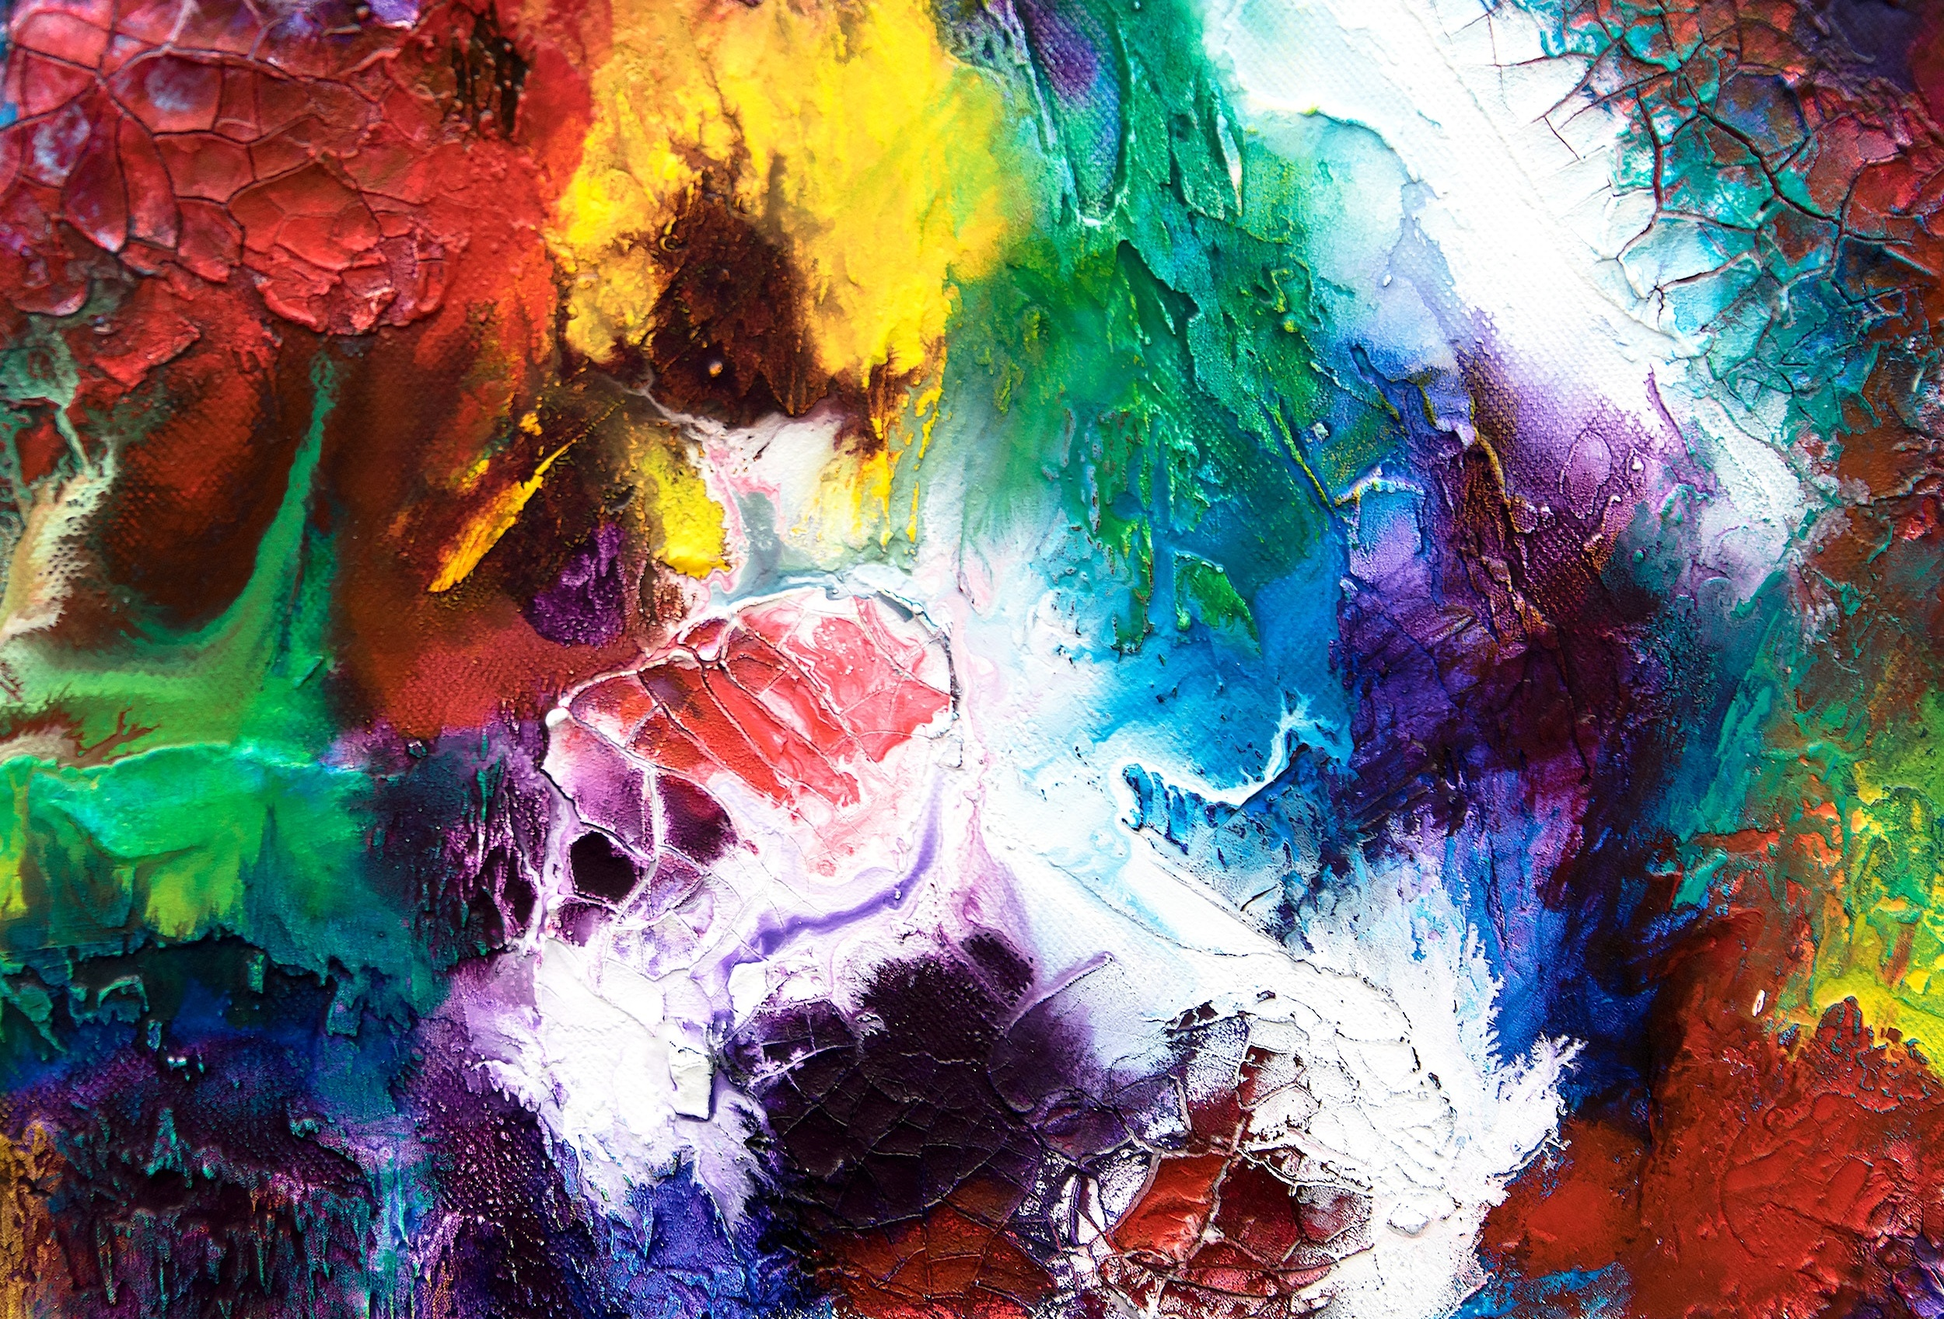
the dataset

Slide 3
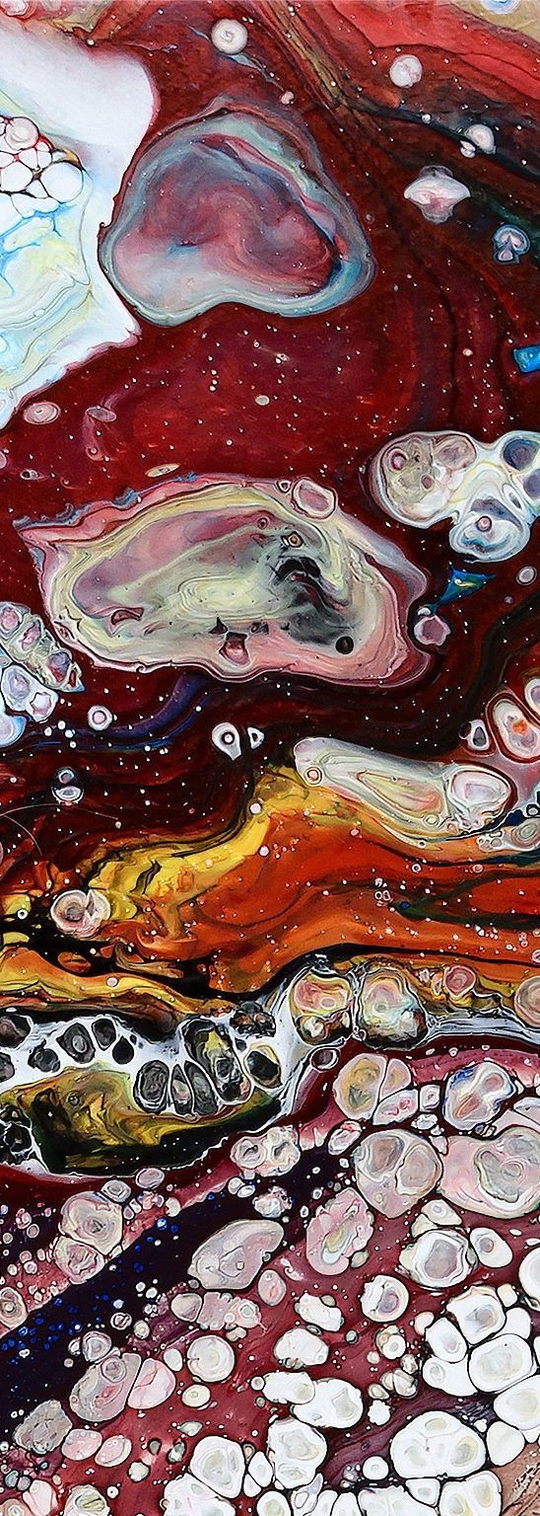
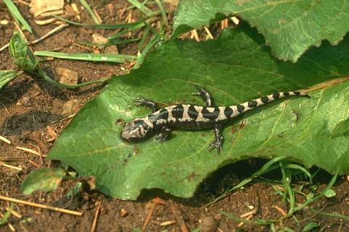
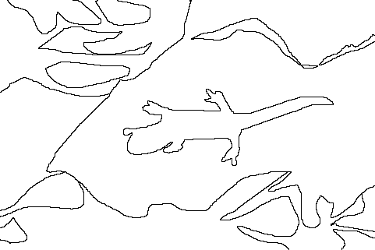
Berkeley segmentation data set
The dataset contains a total of 500 images that are split into:
A training/validation set of 300 images.
A test set of 200 images.
Each image was segmented by five different subjects on average.
Original Image
Ground Truth #1

Slide 4
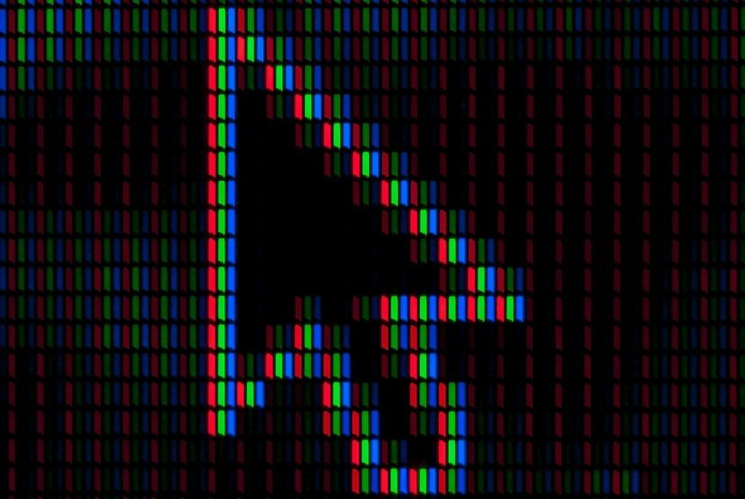
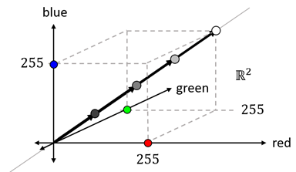
SEGMENTATION APPROACH
im[100, 100] = [0, 100, 50]
Vector representation of a pixel in 3D RGB color space.

Slide 5
kMEANS SEGMENTATION

Slide 6
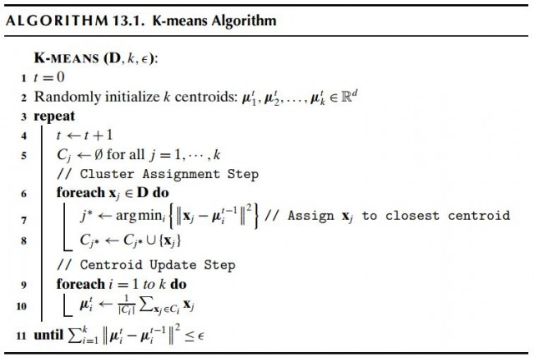
kMeans clustering

Slide 7
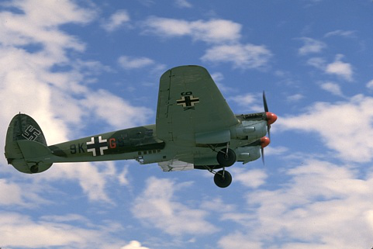
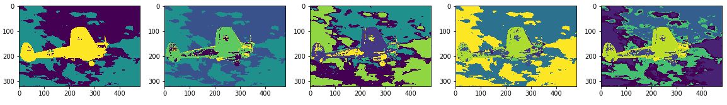
QUALITATIVE RESULTS
K=7
K=3
K=5

Slide 8
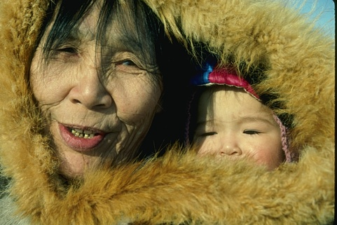
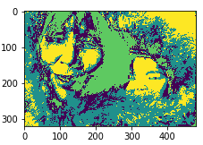
QUALITATIVE RESULTS (K=5)

Slide 9
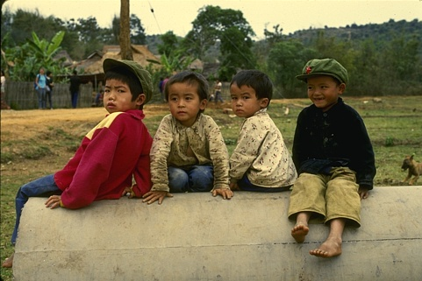
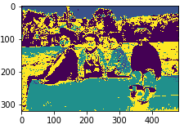
QUALITATIVE RESULTS (K=5)

Slide 10
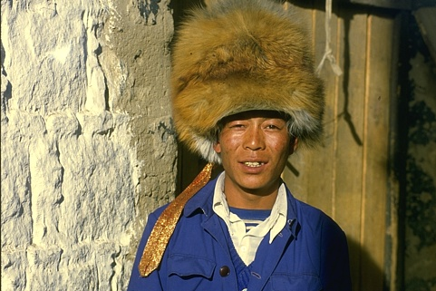
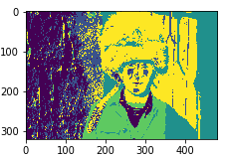
QUALITATIVE RESULTS (K=5)

Slide 11
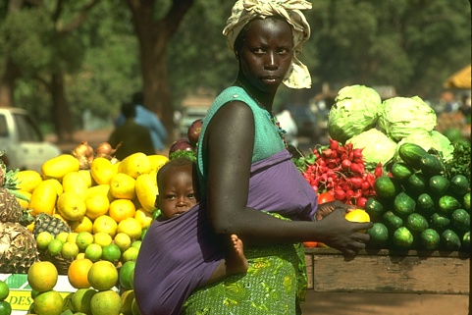
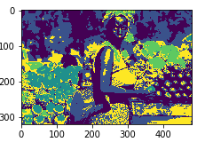
QUALITATIVE RESULTS (K=5)

Slide 12
Spectral clustering

Slide 13
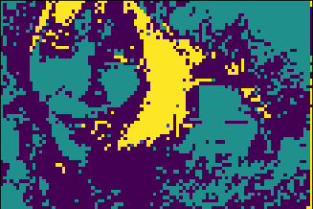
SPECTRAL CLUSTERING

Slide 14
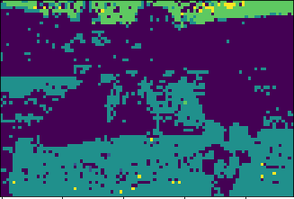
SPECTRAL CLUSTERING

Slide 15
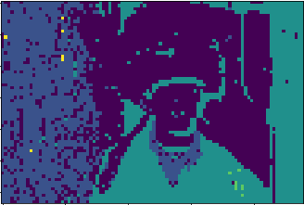
SPECTRAL CLUSTERING

Slide 16
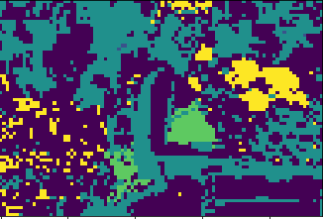
SPECTRAL CLUSTERING

Slide 17
THANK YOU
PATTERN RECOGNITION
Amr Mustafa
Mostafa Mahmoud

